Slide 1
Railway Reservation System
Group Members:
Hamid Ali Khan
Mohtasim Arif

Slide 2
Introduction
Our system is particularly concerned about customers making reservations of tickets.
Store and retrieve information about passengers, tickets, trains and their sources and destinations.
Maintain records of all the passengers who travels using our reservation system

Slide 3
Scope
Computerize Manual Work
Maintain Records in Database instead of manual storage
Introduce a system that solves problems typically associated with manual systems

Slide 4
Features
Data is at the hands of users
Time saving
Accurate Data

Slide 5
Entities
The following are the entities involved in the reservation system
User
Station
Train
Class
Ticket
Passenger
Address

Slide 6
User and its Attributes
User_name (P.K)
User_password

Slide 7
Station and its Attributes
Station_id (P.K)
Station_name

Slide 8
Train and its Attributes
Train_id (P.K)
Train_name
Train_source (F.K)
Train_Destination (F.K)
Departure_time

Slide 9
Class and its Attributes
Class_id (P.K)
No_of_seats
Base_fare
Train_id (F.K)

Slide 10
Ticket and its Attributes
Ticket_no (P.K)
Seat_no
Price
Class_id (F.K)
Train_id (F.K)

Slide 11
Passenger and its Attributes
Passenger_id (P.K)
First_name
Last_name
DOB
GENDER
Mobile_no
User_name (F.K)
Address_id (F.K)
Ticket_no (F.K)

Slide 12
Address and its Attributes
Address_id (P.K)
City
Province
Zip_code

Slide 13
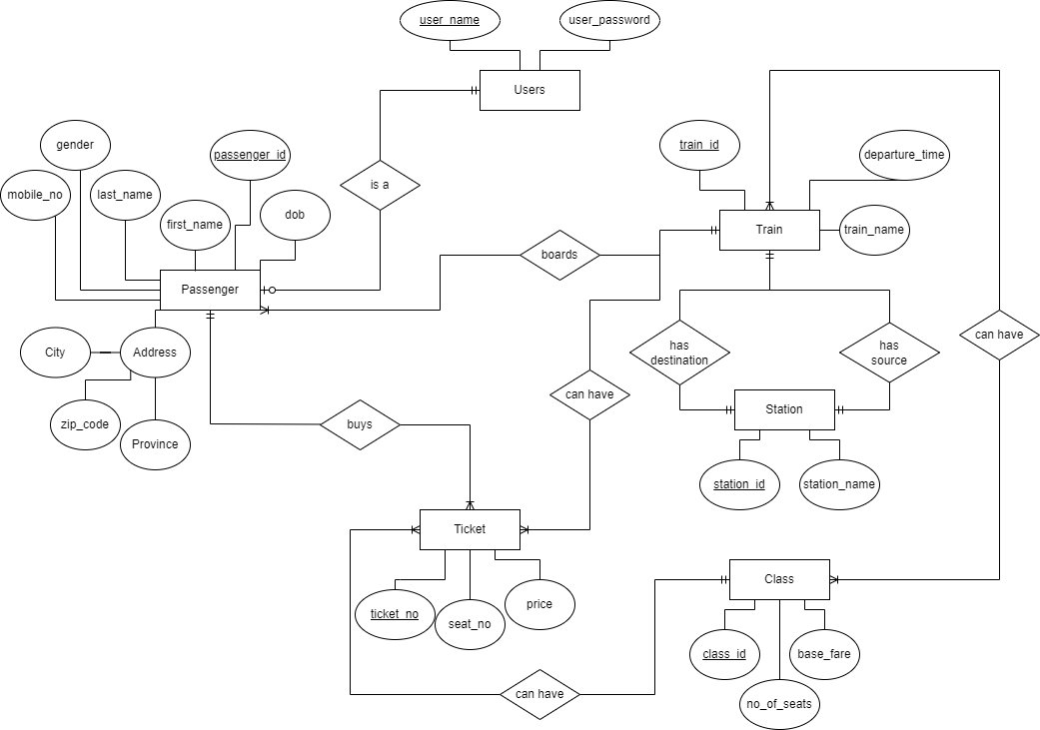
ER Diagram

Slide 14
Database Schema
Users
user_name | user_password
Station
station_id | station_name
Train
train_id | train_name | train_source | train_destination | departure_time
Ticket
ticket_no | seat_no | price | class_id | train_id
Classes
class_id | no_of_seats | base_fare | train_id
Ticket_Classes
class_id | train_id
Passenger
passenger_id | first_name | last_name | dob | gender | mobile_no | user_name | address_id | ticket_no
Address
address_id | city | province | zip_code

Slide 15
Lets move on to SQL DEVELOPER

Slide 16
THANK YOU!

